Slide 1
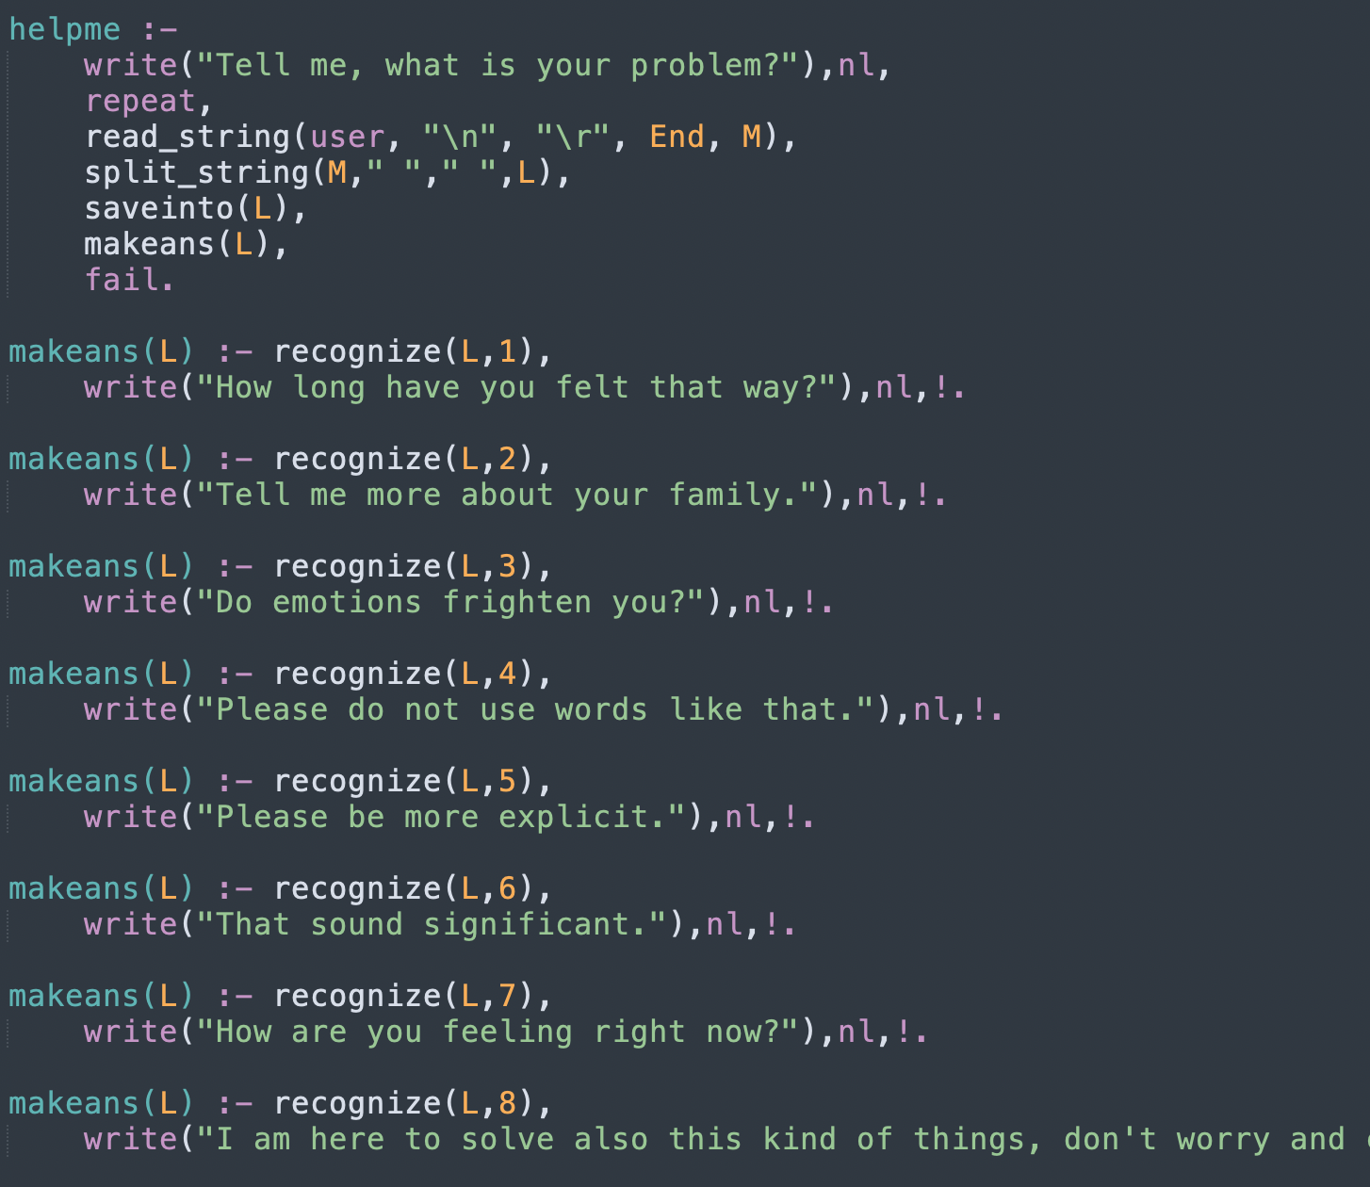

Slide 2
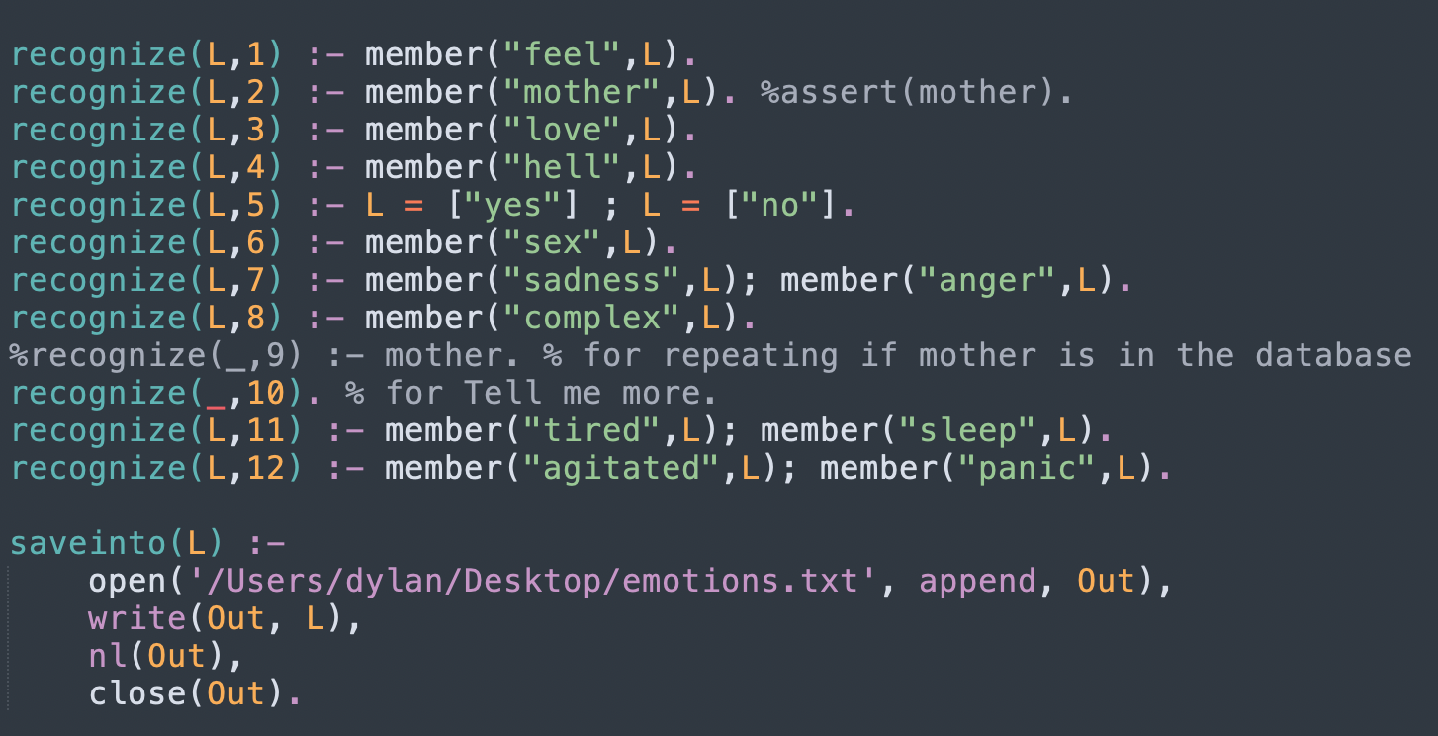

Slide 3
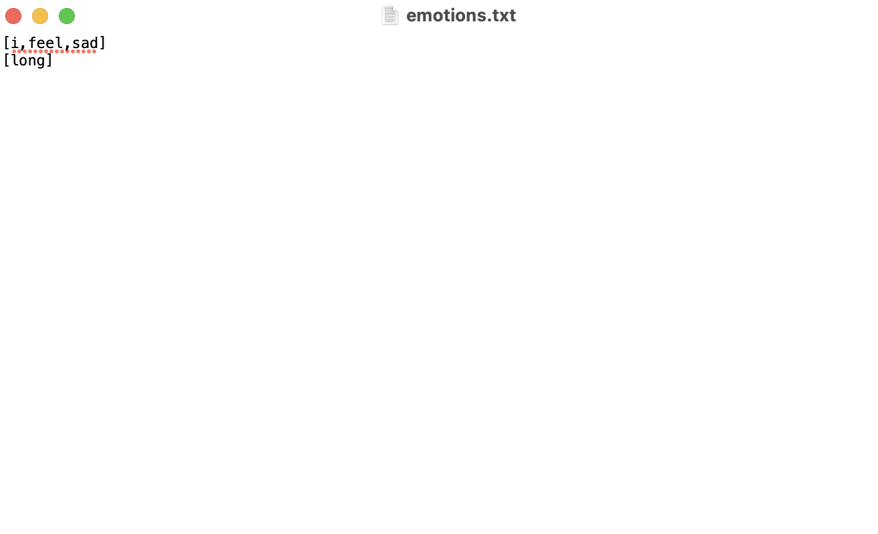
helpme: predicate which starts the chat with the user
Read the answer of the user, parse it and save it into a txt file .
The string is parsed this way → if the response is «i feel sad» → in the file will be present [i,feel,sad].
Then, makeans(L) predicate it is called, where L is a list which contains [i,feel,sad] for example (i.e, the answer the user typed).
recognize(L,n)
Returns True iif there are some words in the list L
Makeans(L): formulate a (static) answer given a pattern.
Pattern is recognized with the predicate recognize(L,n), where n is a number that enumerate the pattern (i.e, recognize(L,2) indicates that the pattern to consider is the number 2).

Slide 4
Execution example:
We write «i feel sad»
[i,feel,sad] is saved into emotions.txt
Makeans(L=[i,feel,sasd]) :- recognize(L,1).
Recognize(L, 1) :- member(feel,[i,feel,sad]) (True)
Backtracking on makeans which write on screen the phrase «how long have you felt that way?»
Then the user can type something else and the pattern matching will do the job (i,e. if you type «mother», the recognize(L,2) will be called and makeans will produce the prhase «Tell me more about your family»)

Slide 5
If no pattern is matched, the predicate recognize(_,10) will be called and the answer of the bot wil be «Tell me more», which is kind a way to make the conversation going.
The _ term indicates that no matter how the value of L is (no matter the answer the user typed).
You can play with it typing words like anger, sadness, hell, complex (the words that are in the recognized predicate)

Slide 6
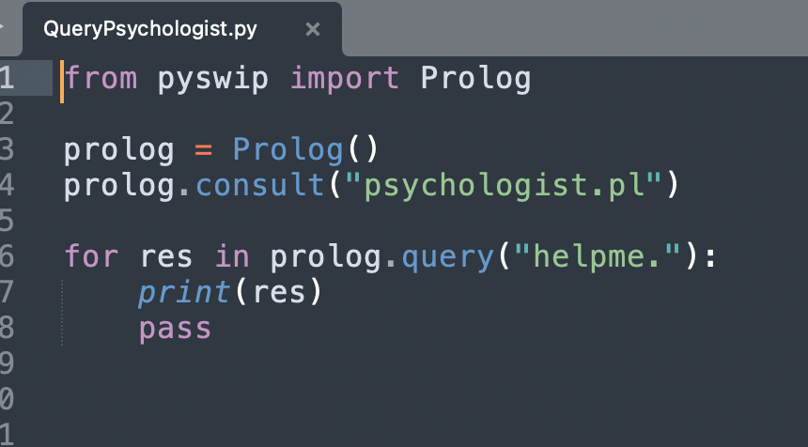
On python, you can query it and see the result (maybe it is not needed).
NOTE: jupyter nothebook doesn’t display anything (at least for me). I have to execute it on terminal (or maybe another IDE idk)

